Slide 1

strcat() and strncat() in C
Farjan Ahmmed
ID : 232-35-738

Slide 2
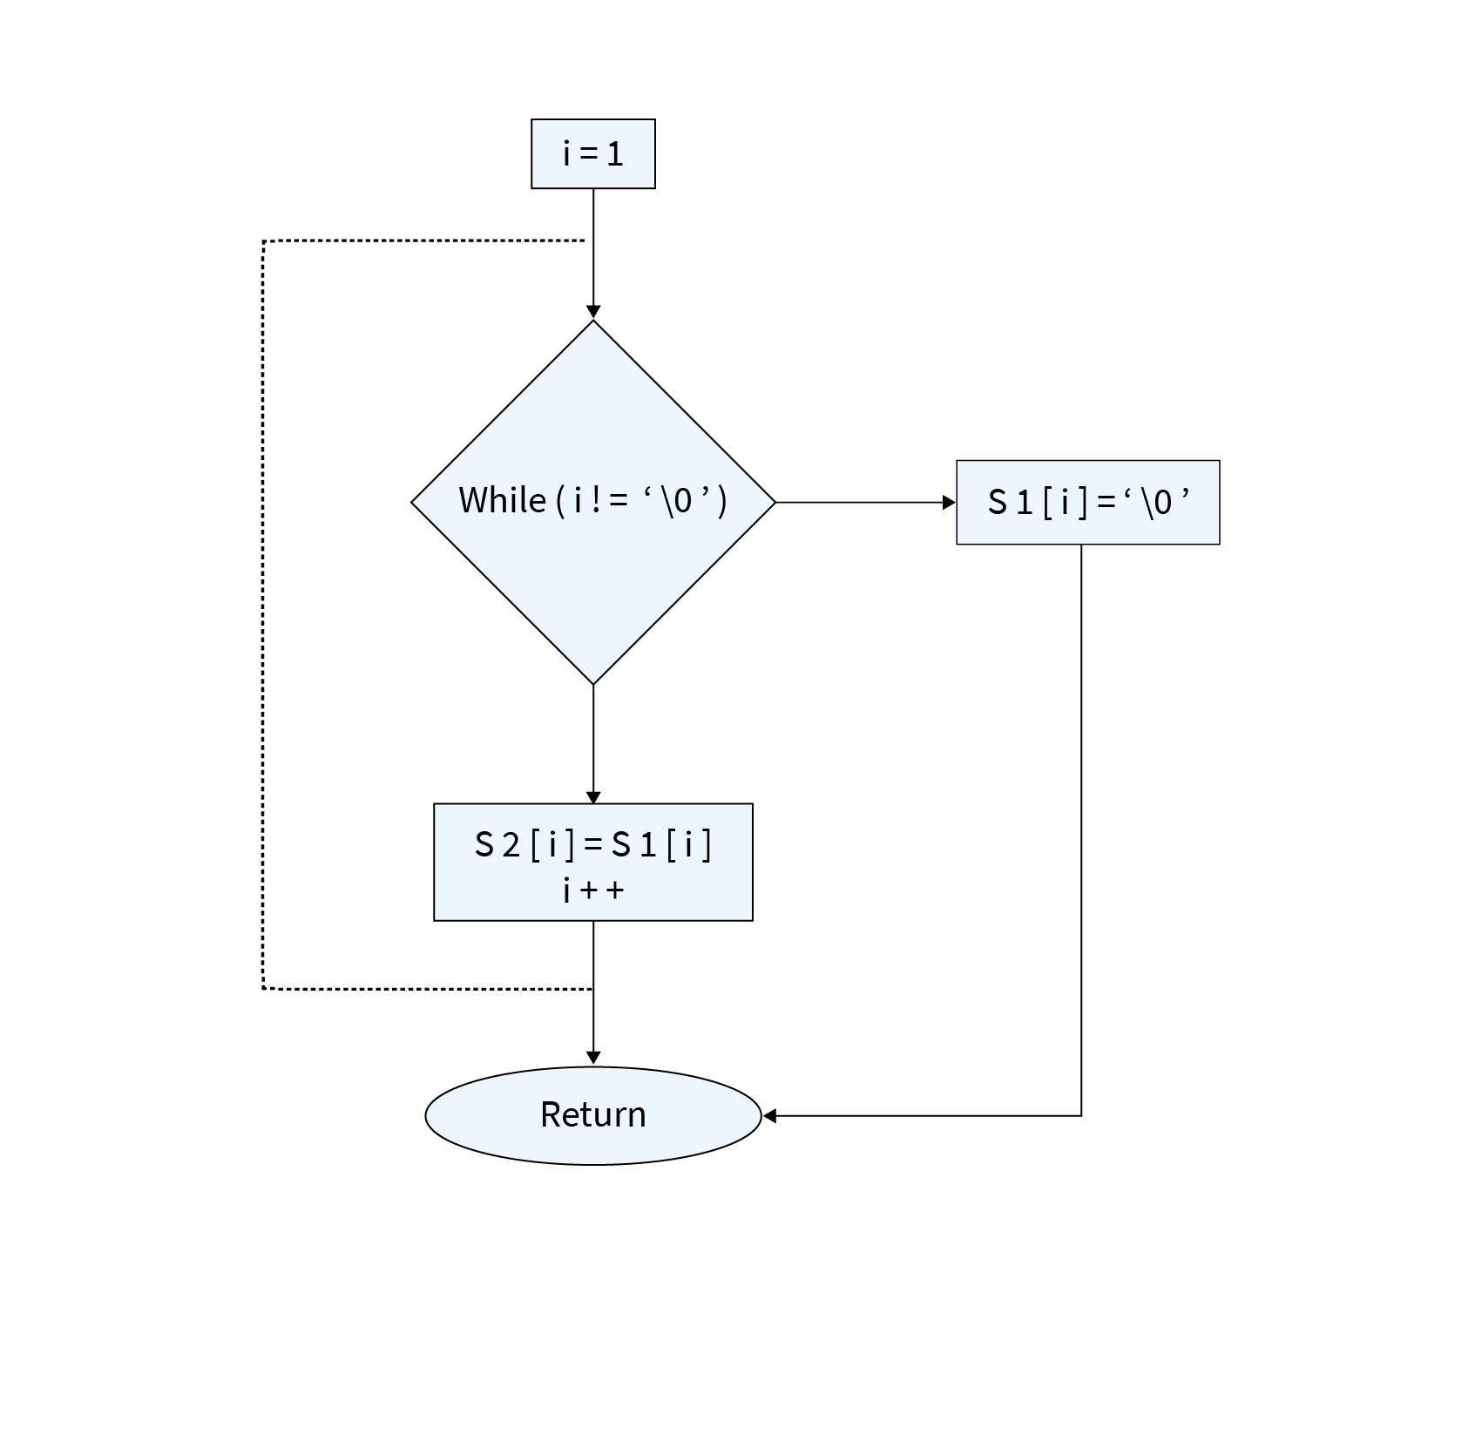
Understanding The strcat() function
The strcat() function is used to concatenate two strings.
It appends the source string to the destination string.
The resulting string is stored in the destination array.

Slide 3
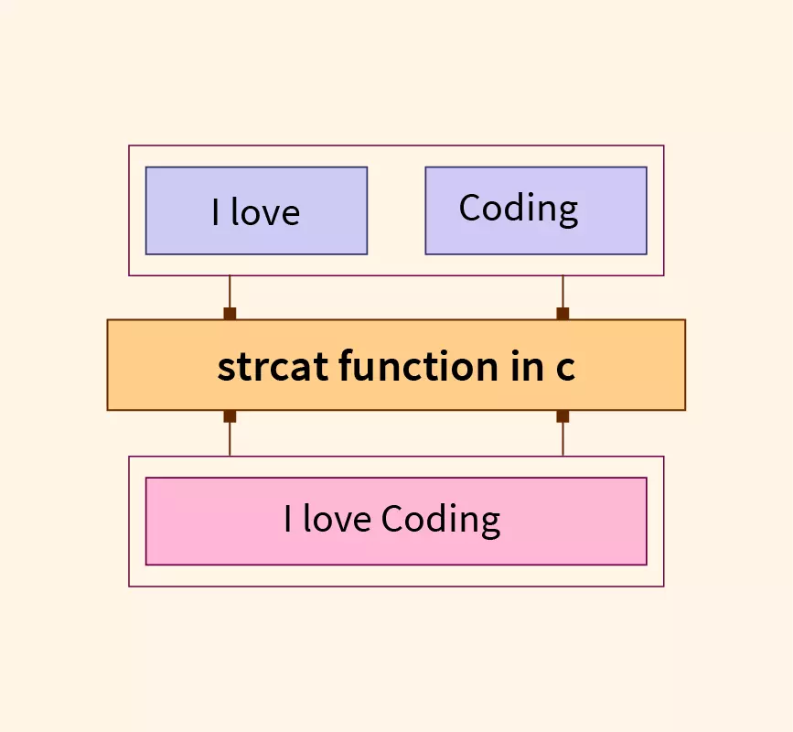
Parameters of strcat() Function in C
char *strcat(char *destination, const char *source);
Destination : This is a pointer to the string where the concatenated string is to be stored.
Source : This is a pointer to the string that is to be concatenated. It is the string that will be appended to the destination string.

Slide 4
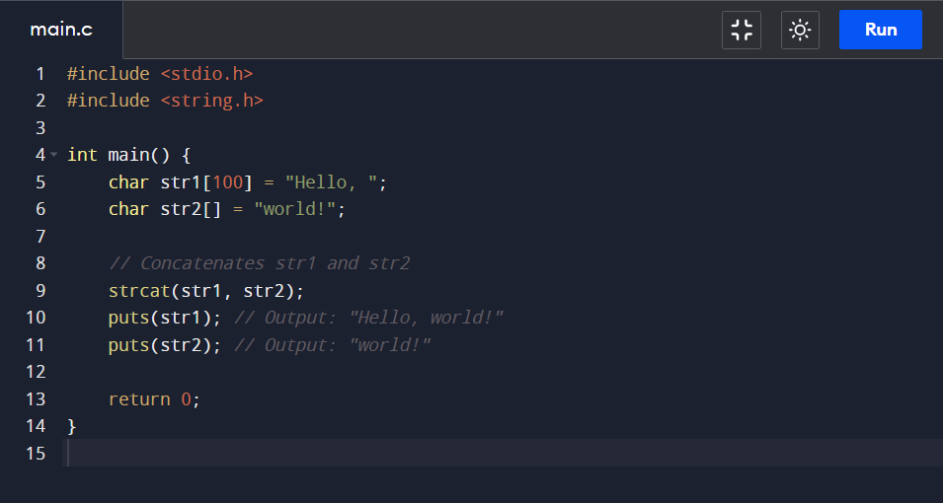
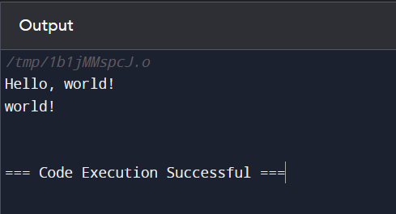
Example of Strcat Function
Concatenating two strings :

Slide 5
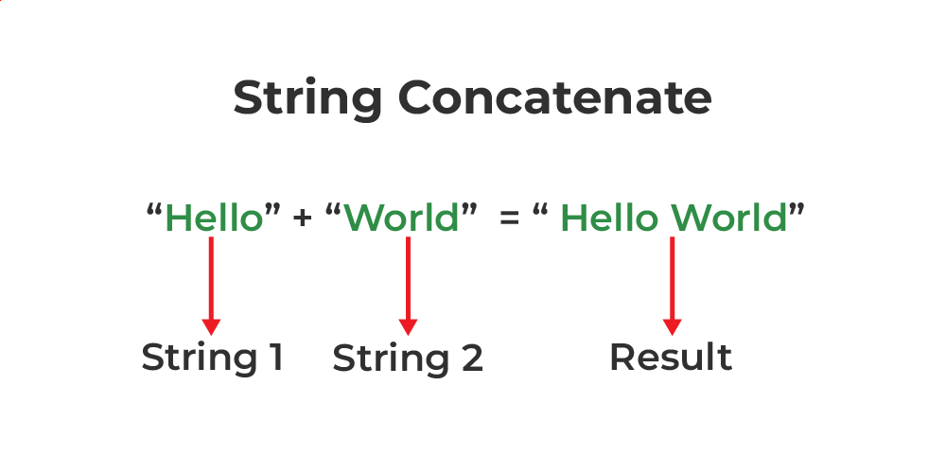
Steps For The Code
Lets Input two character type arrays (strings):
str1 is initialized with the value "Hello, ".
str2 is initialized with the value "world!".
The strcat() function is used to concatenate these two strings. It appends the contents of str2 to the end of str1.
After concatenation, str1 becomes "Hello, world!".
Lastly the program prints both str1 and str2.

Slide 6
Understanding The strncat() function
The strncat() function is similar to strcat() but with an added safety feature.
It appends the first n characters of the source string to the destination string.
It ensures that the destination string does not overflow by specifying the maximum number of characters to append.

Slide 7
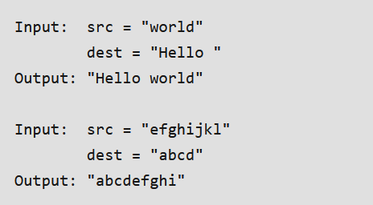
Parameters of strncat() Function in C
char *strncat(char *dest, const char *src, size_t n)
dest: the string where we want to append.
src: the string from which ‘n’ characters are going to append.
n: represents a maximum number of characters to be appended. size_t is an unsigned integral type.
Return Value: The strncat() function shall return the pointer to the string(dest).

Slide 8
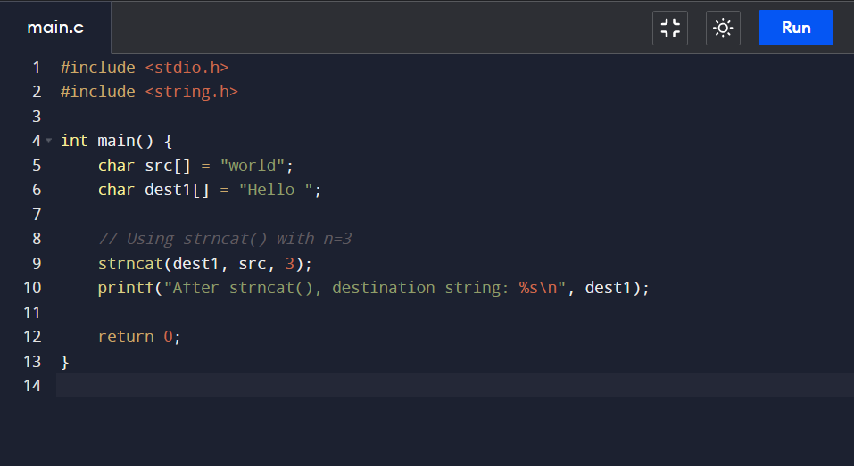
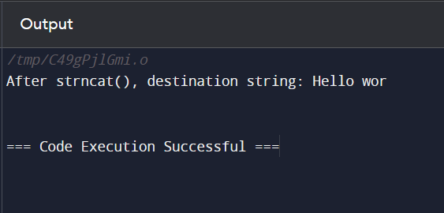
Example of Strncat Function

Slide 9
Steps For The Code
We start with two strings: src (“world”) and dest1 ("Hello ").
1
If we do this for strcat(dest1, src) it will append src to dest1, resulting in “Hello world”.
2
strncat(dest1, src, 3) appends only the first 3 characters of src to dest2, resulting in “Hello wor”.
3

Slide 10
Thank You

